Slide 1
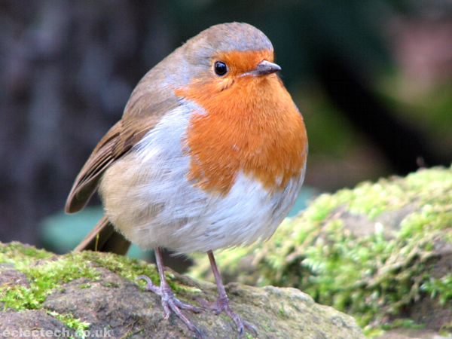
Welcome to Year 2

Slide 2
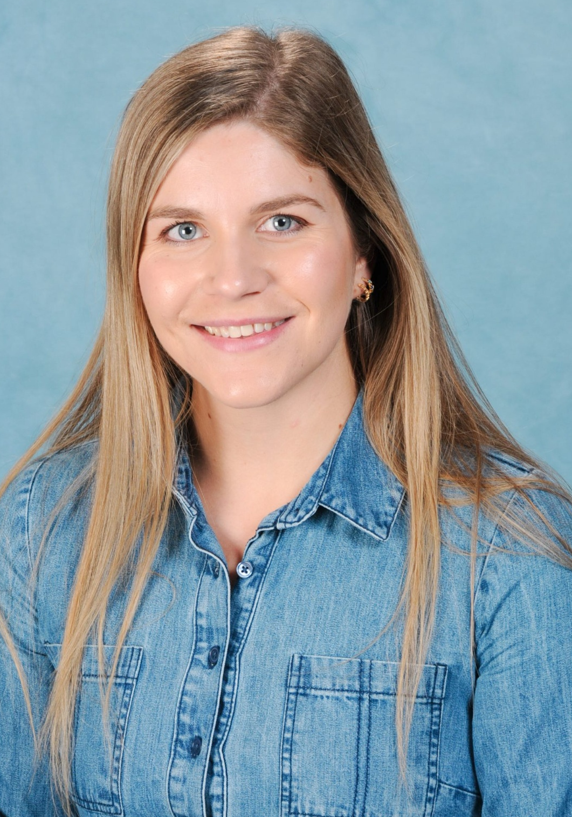
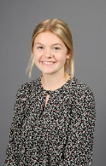
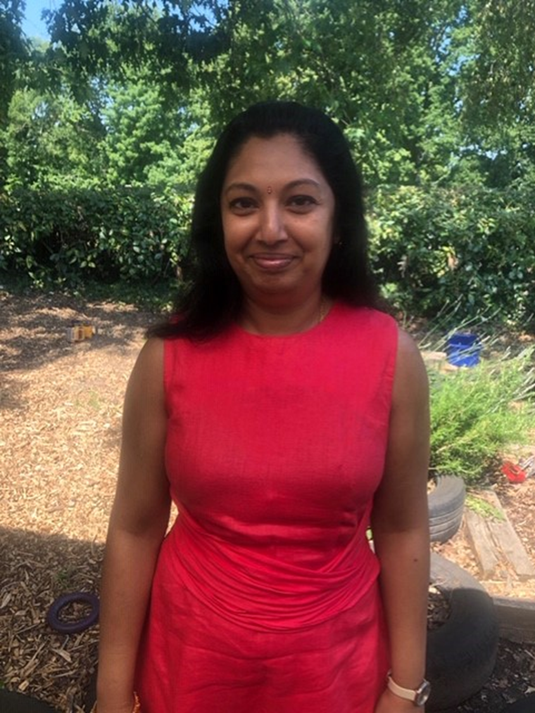
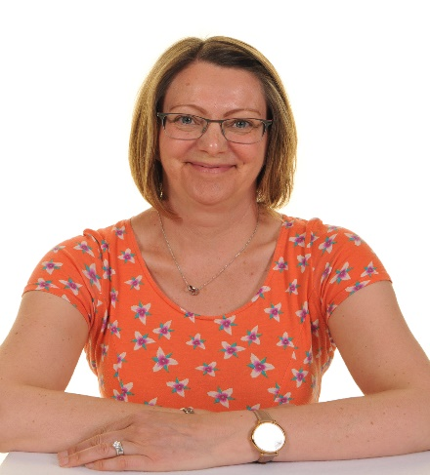
Meet the team
Robins
Miss Abraham – Class teacher
Swallows
Miss Latter– Class teacher
Mrs Longman - LSA
Mrs Dushi- LSA

Slide 3
Expectations
Learning is more structured but there is still some focus on child led learning.
We encourage independence, resilience and responsibilities in year 2.
Children are encouraged to take pride in their work and can earn a ‘’special pencil’ during year 2.

Slide 4
Responsibilities and expectations
All children will be encouraged to change their books, read at home and be responsible for their belongings. We expect the children to read 5 times during the week.
We encourage children to have a responsible job such as: setting up for assembly, handing jumpers out or sharpening pencils.

Slide 5
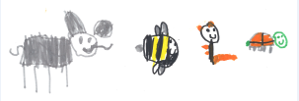
Behaviour and expectations
We reward good behaviour and super effort.
We use positive praise, certificates and our learning hero-based charter to encourage positive behaviour and a good attitude to learning.
Each class has a class reward system to encourage team work.
At Calmore we are…
Respectful
Safe
Ready

Slide 6
Logistics
8.30am drop off at playground doors.
3pm pick up at Year 2 classroom doors. (through rear gate)

Slide 7
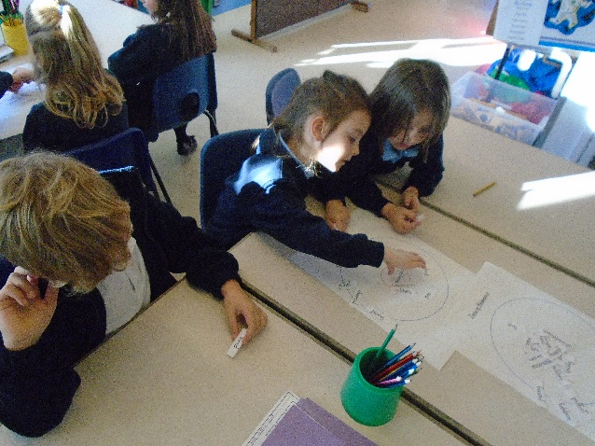
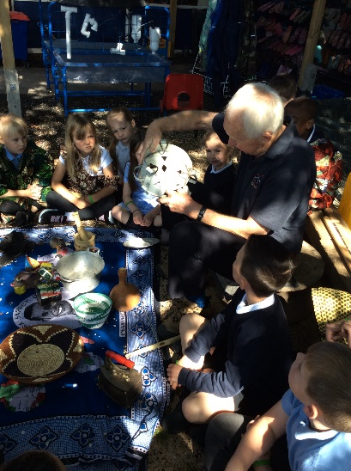
A typical day in Year 2
8:35 Register & morning maths
8.55 Sound group 9.35 Handwriting 9.50 Literacy
10:30 Assembly
10:45 Playtime
11:00 Maths
12:00 Lunch
1:00 Foundation subjects / science/
Art /DT /PE/ music/ RE
2:45 Story time
3: 00 Home time
Key days PE – Tuesday & Wednesday Library – Tuesday
Music – Wednesday

Slide 8
Topics for the year
Autumn Term
Autumn 1 – Snail’s World Adventure – A geography led topic locating places around the world, using maps and globes. Linking to science looking at life cycles and launching our long term study of our grounds.
Autumn 2 – Neil Armstrong–A history led topic focusing on Neil Armstrong and his achievements. In DT children will learn to sew a Christmas decoration for the tree.
Spring Term
Spring 1 - Great Fire of London– History of the events leading up to the Great fire of London. DT making fire engines using axles and wheels.
Spring 2 – Animals & Habitats – Visit to Beaulieu to learn about animals and their habitats. Towards Easter, we discuss the Easter story with a focus of welcoming people.
Summer Term
Summer 1 - Uganda– A geography topic comparing Uganda to the UK, Link with Kagando school in Uganda. Science learning growing new plants and plant survival.
Summer 2 - Castles – Visit Portchester Castle as a local historical place. Children will prepare and make food for a Medieval banquet.

Slide 9
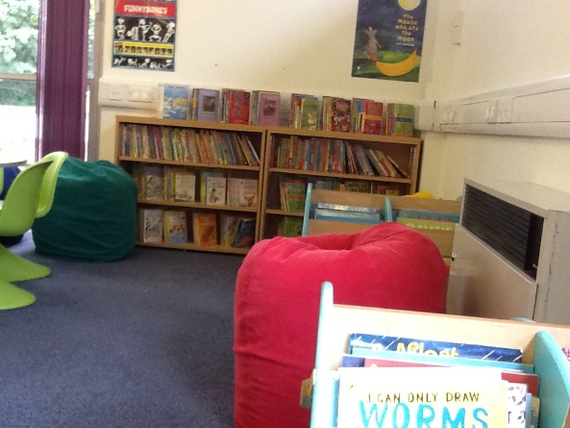
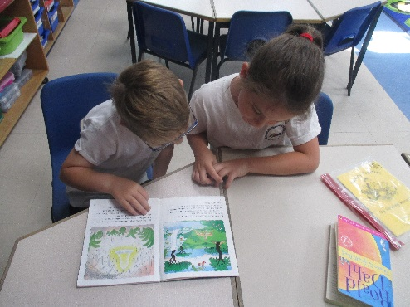
Home - school learning
Books
RWI reading book and phonics book bag book once a week, your child bring home a book linked to their phonics level. It is important reading folders are in school every day.
Library Book– Please share the book your child has chosen.
Library day: Tuesday every week (but ensure it is in your child’s book bag daily).

Slide 10
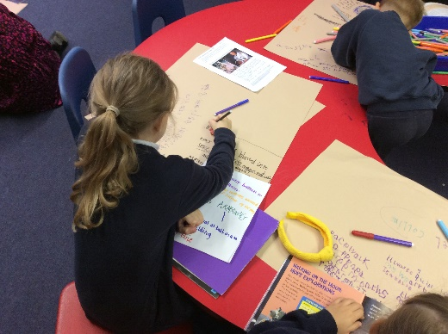
Home - school learning
Spellings– your child will be learning in class a spelling pattern/rule this can also include red words. These will be sent home and tested on a Friday, please help them to practise these. This will begin during the autumn term.
Half-term projects- Children will be given home learning to complete over the half term, which will link to our topic. Any home learning will be shared and displayed in class.

Slide 11
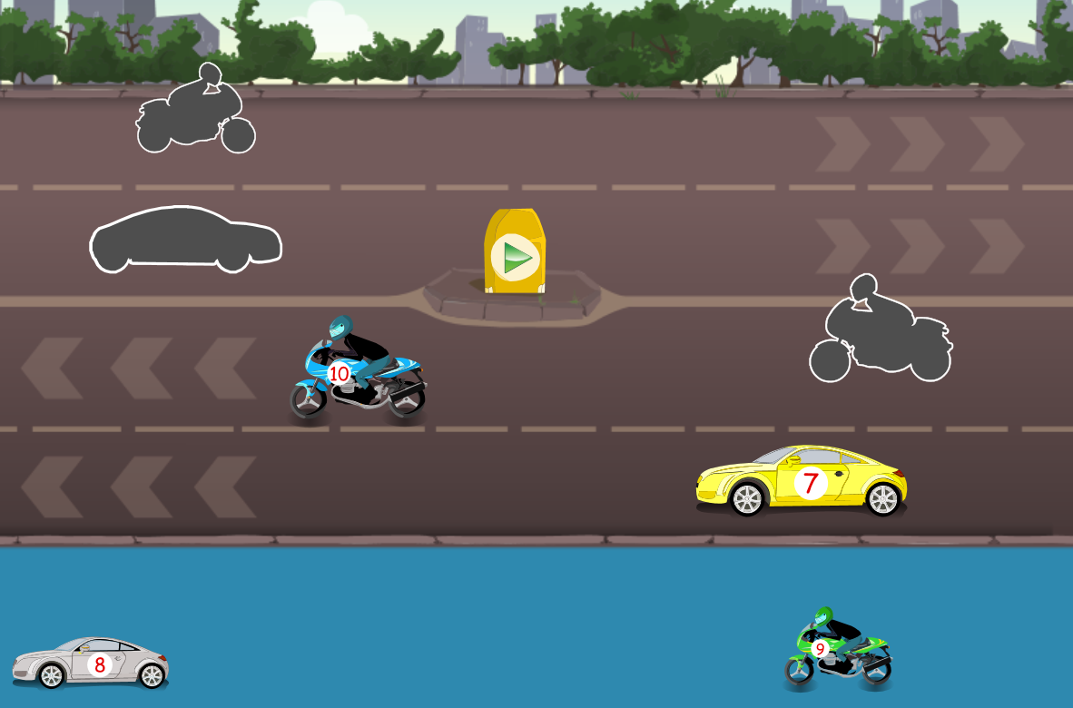
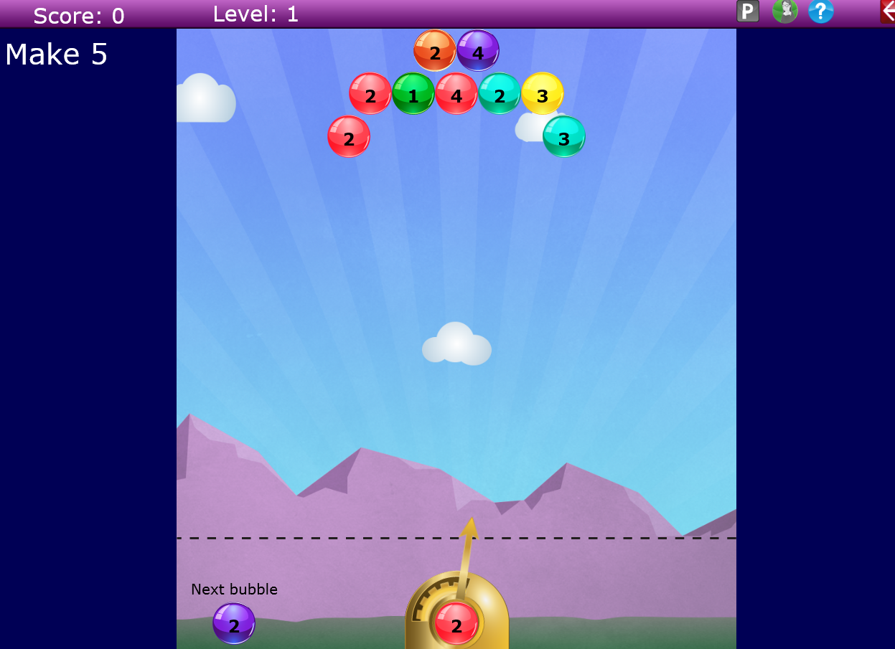
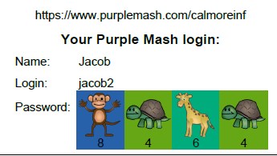
Purple Mash
A fast, interactive, exciting learning resource designed specifically for your child in a safe online environment. Offers support for parents on the curriculum and allows you to be part of your child’s learning.

Slide 12
Uniform
Please ensure your child has a book bag and reading folder in school everyday.
Refillable drink bottle in school.
PE kits to be worn on a Tuesday and Wednesday – please provide earring tape (no hoops) and hair tied up.
Wellies and water suit (optional)
Make sure your child has a named coat in school.

Slide 13
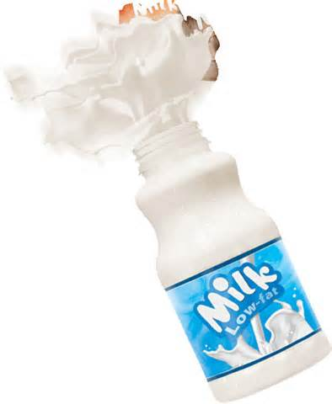
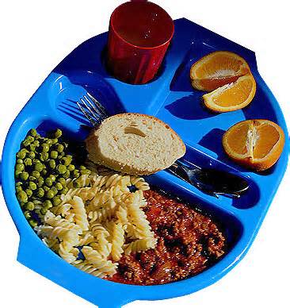
Reminders
If your child is ill…..phone the school on the first day of absence.
Let us know if someone else is collecting your child, by putting a message in the diary (at the office).
Milk is no longer free but lunches and fruit for snack are.

Slide 14
A little plea for help...
Could you possibly spare a little bit of time during the week?
Are you DBS checked? Could you come on trips with us, listen to children read?
If you can please speak to Nic or us!

Slide 15
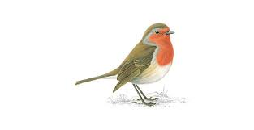
Thank you for your support
We are looking forward to working with you and your children this year.

